Slide 1
Ch 5 Advanced Data Modeling Exercises

Slide 2
1. Given the following business scenario, create a Crow’s Foot ERD using a specialization hierarchy if appropriate.
Two-Bit Drilling Company keeps information on employees and their insurance dependents. Each employee has an employee number, name, date of hire, and title. If an employee is an inspector, then the date of certification and the renewal date for that certification should also be recorded in the system. For all employees, the Social Security number and dependent names should be kept. All dependents must be associated with one and only one employee. Some employees will not have dependents, while others will have many dependents.

Slide 3
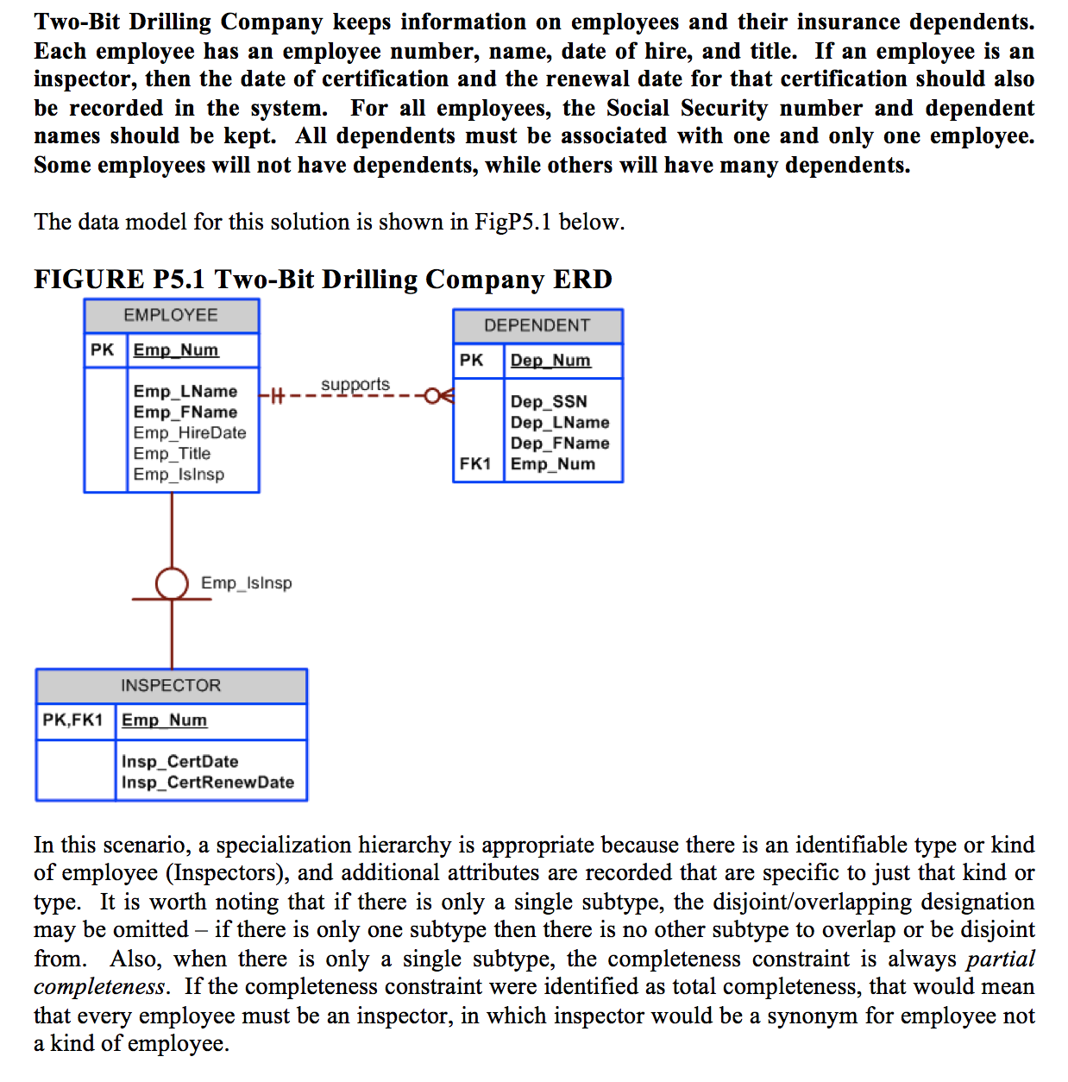

Slide 4
2. Some Tiny College staff employees are information technology (IT) personnel. Some IT personnel provide technology support for academic programs. Some IT personnel provide technology infrastructure support. Some IT personnel provide technology support for academic programs and technology infrastructure support. IT personnel are not professors. IT personnel are required to take periodic training to retain their technical expertise. Tiny College tracks all IT personnel training by date, type, and results (completed vs. not completed). Given that information, create the complete ERD containing all primary keys, foreign keys, and main attributes.

Slide 5
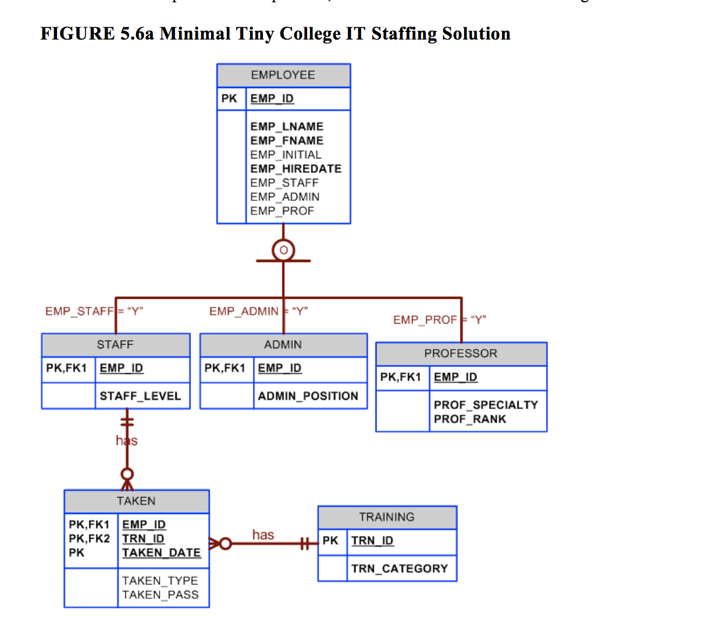

Slide 6
